Slide 1


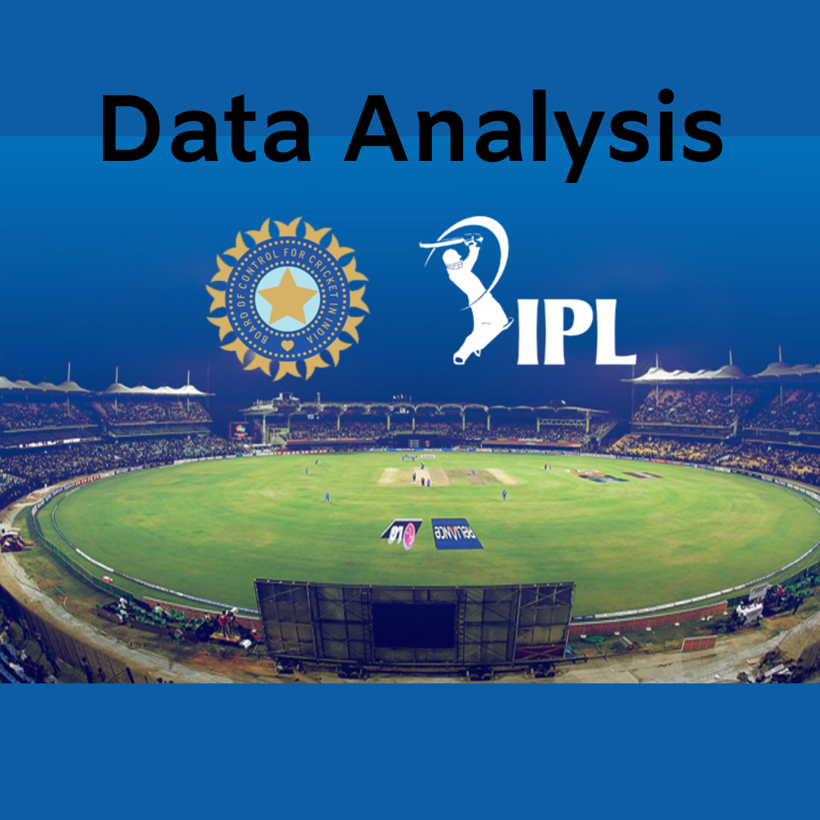
IPL Analysis
Prepared by :- Sumit Singh
Technology :- SQL
Dataset :- IPL (2008-2016)
Analyse Team Performance,
Player Statistics and Match Insights

Slide 2

Agenda
Problem Statement
Data Description
Objective Key Metrics and Visualizations
Subjective Question for Insights
SQL Project:- IPL Analysis

Slide 3
Dataset Overview
IPL dataset covers 9 seasons (2008–2016).
Contains 18 relational tables with match, player, team, venue, and season information.
Includes ball-by-ball data, runs, wickets, extra runs, batting and bowling statistics.
SQL was used to analyze team performance, player performance, venue insights, and season-wise trends.
The dataset supports data-driven decision-making through KPIs and performance analysis.

Slide 4
List the top 10 players according to their strike rate in the last 4 seasons.
RV Gomez recorded the highest strike rate of 400.00, making him the most aggressive batsman in the last four seasons.
AN Ahmed (233.33) and CR Brathwaite (207.50) also achieved excellent strike rates, indicating highly impactful batting performances.
The Top 10 players all maintained a strike rate above 169.

Slide 5
What are the average runs scored by each batsman considering all the seasons?
RV Gomez recorded the highest average runs
per ball (4.00), followed by AN Ahmed (2.33)
and CR Brathwaite (2.18).
Most batsmen maintained an average between
1.30 and 2.00 runs per ball, indicating consistent
batting performance across all IPL seasons.

Slide 6
List all the players who have average runs scored greater than the overall average and who have taken wickets greater than the overall average.
AN Ahmed achieved the highest batting average (2.33) among players who also took above-average wickets, showing excellent all-round performance.
JP Faulkner (122 wickets), Harbhajan Singh (118 wickets), and CH Morris / SR Watson / R Vinay Kumar (91 wickets each) were the most effective all-round contributors.

Slide 7
What is the impact of bowling style on wickets taken?
Right-arm medium bowlers dominated the tournament with 1,173 wickets, making them the most successful bowling style.
Right-arm fast-medium (735) and Right-arm medium-fast (642) were the next best-performing pace bowling styles, consistently taking a high number of wickets.

Slide 8
Suggest some of the players who would be best fit for the team.
Virat Kohli scored the highest runs (2472), followed by David Warner (2348) and AB de Villiers (1968).
Ravindra Jadeja (101 wickets), Shane Watson (91 wickets), and Kieron Pollard (44 wickets) stand out as the best all-round contributors.

Slide 9
What are some of the parameters that should be focused on while selecting the players?
Players who contribute in both batting and bowling (all-rounders) provide better balance and flexibility to the team.
Virat Kohli, Rohit Sharma, Suresh Raina, Ravindra Jadeja, Dwayne Bravo, JP Faulkner, and Shane Watson are among the best choices based on overall performance.

Slide 10
Which players offer versatility in their skills and can contribute effectively with both bat and ball?
Hardik Pandya, Mitchell Marsh, Marcus Stoinis, Mitchell Johnson, and Dwayne Wiese contributed effectively with both bat and ball.
Selecting versatile players improves team balance, match flexibility, and overall performance, making them ideal choices for the playing XI.

Slide 11
What do you think could be the factors contributing
to the high-scoring matches and the impact on viewership and team strategies?
RCB recorded the highest team total (263 runs), followed by other strong batting performances from Chennai Super Kings, Mumbai Indians, and Kings XI Punjab.
High-scoring matches are mainly influenced by batting-friendly pitches, powerful batting line-ups, small boundaries, and venue conditions.

Slide 12
Are there players whose presence positively influences the morale and performance of the team?
Virat Kohli, David Warner, AB de Villiers, Rohit Sharma, and Suresh Raina stand out as consistent batting performers who boost team confidence through reliable run scoring.
Players with high runs and/or significant wicket-taking ability positively influence team morale, strengthen overall performance, and improve the team's chances of winning important matches.

Slide 13
Which of the given players have consistently performed well in past seasons?
AB de Villiers, Virat Kohli, Suresh Raina, David Warner, and Ajinkya Rahane showed consistent run-scoring performances across multiple IPL seasons.
The line chart highlights season-wise performance trends, making it easy to identify players whose performance remained stable or improved over time.

Slide 14
Has the team's performance improved compared to the previous year based on runs scored and wickets taken?
Teams with higher Total Runs and Total Wickets than the previous season are classified as Better, while lower values indicate Worse performance. Mixed results are marked as Mixed.
The visualization clearly shows season-to-season changes in team performance, making it easy to compare trends across different teams.

Slide 15
Can you derive more KPIs for the team strategy?
Net Run Rate (NRR) – Measures overall team performance across the season.
Batting Strike Rate – Average scoring speed of the batting lineup.
Bowling Strike Rate – Average balls required to take a wicket.
Boundary Percentage – Percentage of runs scored through fours and sixes.
Dot Ball Percentage – Percentage of deliveries where no runs were scored.
Average Partnership Runs – Average runs added per wicket partnership.
Top Order Contribution – Runs scored by the top 3 batsmen.

Slide 16
Powerplay Wickets Taken – Wickets picked up during the first six overs.
Home vs Away Win Percentage – Performance comparison at home and away venues.
Player of the Match Contribution – Number of awards won by players from the team.
Fielding Efficiency – Catches, run-outs, and stumpings completed.
Winning Margin Analysis – Average margin of victory by runs or wickets.
Close Match Success Rate – Win percentage in matches decided by fewer than 10 runs or 3 wickets.
Batting First vs Chasing Performance – Comparison of wins in both situations.

Slide 17
IPL Project Summary
Key Findings:-
Identified the top-performing batsmen, bowlers, and all-rounders based on runs and wickets.
Analyzed season-wise team and player performance to measure consistency and improvement.
Compared team performance with previous seasons using runs scored and wickets taken.
Evaluated the impact of venue, toss, batting order, and match conditions on team success.
Derived strategic KPIs such as Win Percentage, Run Rate, Economy Rate, Chasing Success Rate, and Partnership Runs.

Slide 18
Business Recommendations
Project Outcome
Retain consistent performers and impactful all-rounders to strengthen the squad.
Improve bowling performance, especially during powerplay and death overs.
Use venue-specific and toss-based strategies to maximize winning chances.
Focus on building strong batting partnerships and maintaining consistent performances across seasons.
Developed SQL queries to analyze IPL data and extract meaningful insights.
Converted raw cricket data into actionable dashboards and performance metrics.
Enabled data-driven decision-making for team strategy, player selection, and season planning.

Slide 19

Conclusion
Data-driven analysis helps teams make better decisions in player selection and match planning.
Consistent performers and strong all-rounders have the greatest impact on team success.
Team performance depends on batting strength, bowling efficiency, venue conditions, and match strategy.
Continuous monitoring of KPIs can improve team performance and increase winning probability.

Slide 20


